Slide 1
CS-116 Final Project Traffic Simulation
By:
Peter Fitzpatrick

Slide 2
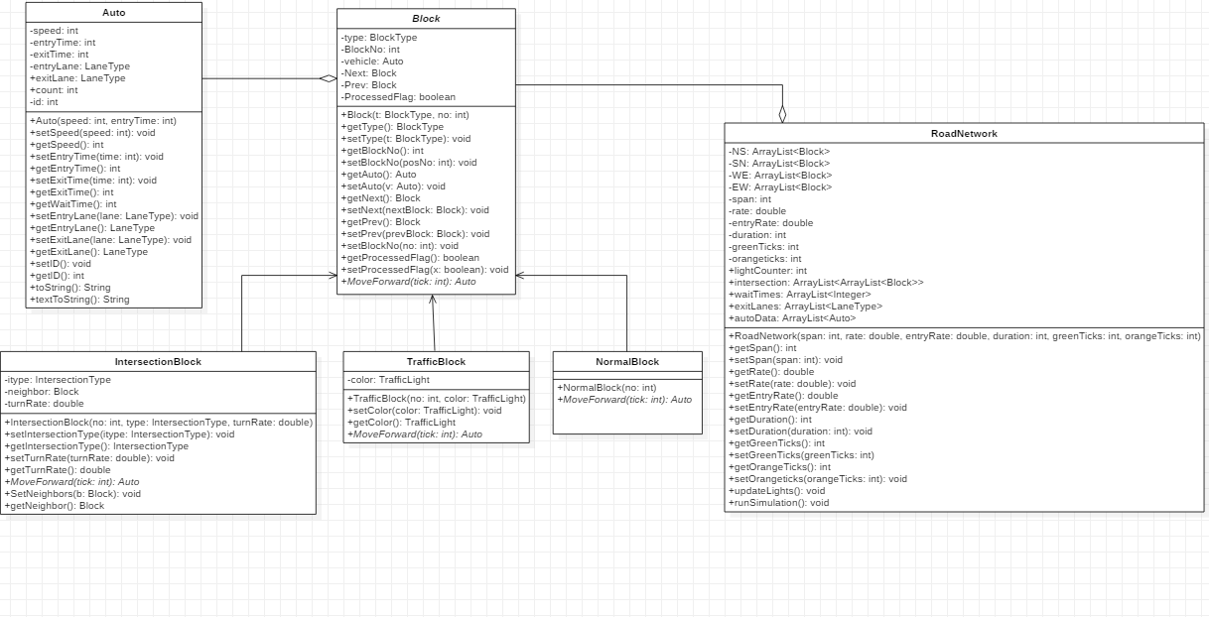

Slide 3
Test Cases: Invalid User Input
Test Case | Output | Tested?
Enter an invalid span i.e. -1 | Invalid Input: Enter the span of the lanes: | Yes
Enter an invalid turn rate i.e. -1 or 2 | Invalid input: Enter the turn rate for the vehicles: | Yes
Enter an invalid entry rate i.e. -1 or 2 | Invalid input: Enter the entry rate for the vehicles: | Yes
Enter an invalid duration i.e. -1 | Invalid Input Enter the amount of ticks you want the program to run for: | Yes
Enter an invalid green light duration i.e. -1 | Invalid Input Enter the amount of ticks for the green light duration: | Yes
Enter an invalid orange light duration i.e. -1 | Invalid Input Enter the amount of ticks for the orange light duration: | Yes

Slide 4
Test Cases continued
Test Case | Output | Tested?
Long vs Short Span i.e. 20 vs 5 | Average wait time: 48.2 ticks. Total Flow Rate: 0.95 vehicles exit per tick. -------------------------------------------- Average wait time: 16.96124031007752 ticks. Total Flow Rate: 1.29 vehicles exit per tick. | Yes, Long Span wait time > Short Span wait time and Long Span Flow Rate < Short Span flow rate
High vs Low entry rate i.e. 0.99 vs 0.1 | Average wait time: 16.963414634146343 ticks. Total Flow Rate: 1.64 vehicles exit per tick. -------------------------------------------- Average wait time: 13.975609756097562 ticks. Total Flow Rate: 0.41 vehicles exit per tick. | Yes, High entry rate wait time > Low entry rate wait time and High entry rate flow rate > Low entry rate flow rate
High vs Low Green and Orange light duration i.e. 20 and 5 vs 4 and 1 | Average wait time: 17.470588235294116 ticks. Total Flow Rate: 1.02 vehicles exit per tick. -------------------------------------------- Average wait time: 15.93525179856115 ticks. Total Flow Rate: 1.39 vehicles exit per tick. | Yes, More total cars exit at the shorter duration and the wait time is shorter

Slide 5
Test Cases continued
Test Case | Output | Tested?
Long vs Short Duration i.e. 100 vs 50 ticks | Average wait time: 16.13953488372093 ticks. Total Flow Rate: 1.29 vehicles exit per tick. --------------------------------------- Average wait time: 14.96551724137931 ticks. Total Flow Rate: 1.16 vehicles exit per tick. | Yes, 129 vehicles exited at 100 ticks while 58 exited at 50 ticks.
High vs low turn rate i.e. 0.99 vs 0.1 | Average wait time: 14.863636363636363 ticks. Total Flow Rate: 1.32 vehicles exit per tick. ---------------------------------------- Average wait time: 15.816 ticks. Total Flow Rate: 1.25 vehicles exit per tick. | Yes, High turn rate has a higher flow rate since the turning route is less blocks than staying forward.
Output to text file | Vehicle ID: 10002, Entry Time: 2, Entry Lane: SN, Exit Lane: WE Vehicle ID: 10000, Entry Time: 0, Entry Lane: WE, Exit Lane: NS … | Yes

Slide 6
Code Segments: Turning
public Auto MoveForward(int tick){
double x = Math.random();
if(x > this.getTurnRate()){
if(super.getNext().getAuto() == null){ //forward
Auto temp = super.getAuto();
super.getNext().setAuto(temp);
super.setAuto(null);
super.setProcessedFlag(true);
return null;
}
else{
this.setProcessedFlag(true);
return null;
}
}
else{
if(this.getNeighbor().getAuto() == null){ //turn
Auto temp = super.getAuto();
this.getNeighbor().setAuto(temp);
super.setAuto(null);
super.setProcessedFlag(true);
return null;
}
else{
this.setProcessedFlag(true);
return null;
}
}
}

Slide 7
Lights
private void updateLights(){
lightCounter++;
if(lightCounter == greenTicks){
((TrafficBlock)(NS.get(span - 1))).setColor(TrafficLight.ORANGE);
((TrafficBlock)(SN.get(span - 1))).setColor(TrafficLight.ORANGE);
}
else if(lightCounter == (greenTicks + orangeTicks)){
((TrafficBlock)(NS.get(span - 1))).setColor(TrafficLight.RED);
((TrafficBlock)(SN.get(span - 1))).setColor(TrafficLight.RED);
((TrafficBlock)(EW.get(span - 1))).setColor(TrafficLight.GREEN);
((TrafficBlock)(WE.get(span - 1))).setColor(TrafficLight.GREEN);
}
else if(lightCounter == (greenTicks + greenTicks + orangeTicks)){
((TrafficBlock)(EW.get(span - 1))).setColor(TrafficLight.ORANGE);
((TrafficBlock)(WE.get(span - 1))).setColor(TrafficLight.ORANGE);
}
else if(lightCounter > 2* (greenTicks + orangeTicks)){
((TrafficBlock)(NS.get(span - 1))).setColor(TrafficLight.GREEN);
((TrafficBlock)(SN.get(span - 1))).setColor(TrafficLight.GREEN);
((TrafficBlock)(EW.get(span - 1))).setColor(TrafficLight.RED);
((TrafficBlock)(WE.get(span - 1))).setColor(TrafficLight.RED);
lightCounter = 0;
} }

Slide 8
Simulation
public void runSimulation(){
for(int i = 0; i < duration; i++){
updateLights();
for(int j = 0; j < 4; j++){
ArrayList<Block> road = intersection.get(j);
if(Math.random() < this.getEntryRate() && road.get(0).getAuto() == null){
Auto temp = new Auto(1, i, LaneType.values()[j], LaneType.values()[j]);
road.get(0).setAuto(temp);
}
for(int k = road.size()-1; k >= 0; k--){
Auto a = null;
if(road.get(k).getAuto() != null){
a = road.get(k).MoveForward(i);
}
if(a != null){ //Move forward returns an Auto and is null unless the next Block is null
waitTimes.add(a.getWaitTime());
exitLanes.add(LaneType.values()[j]);
a.setExitLane(LaneType.values()[j]);
autoData.add(a); }}}}}

Slide 9
Javadoc
Link

